Slide 1
Introduction to Programming

Slide 2

Program
Instruction 1
Instruction 2
Instruction 3
…
Executed by
Computer
Program

Slide 3
Program 2
Read the name of the customer
Read the bank card number
Check the information
Write the balance
…
Balance Program

Slide 4


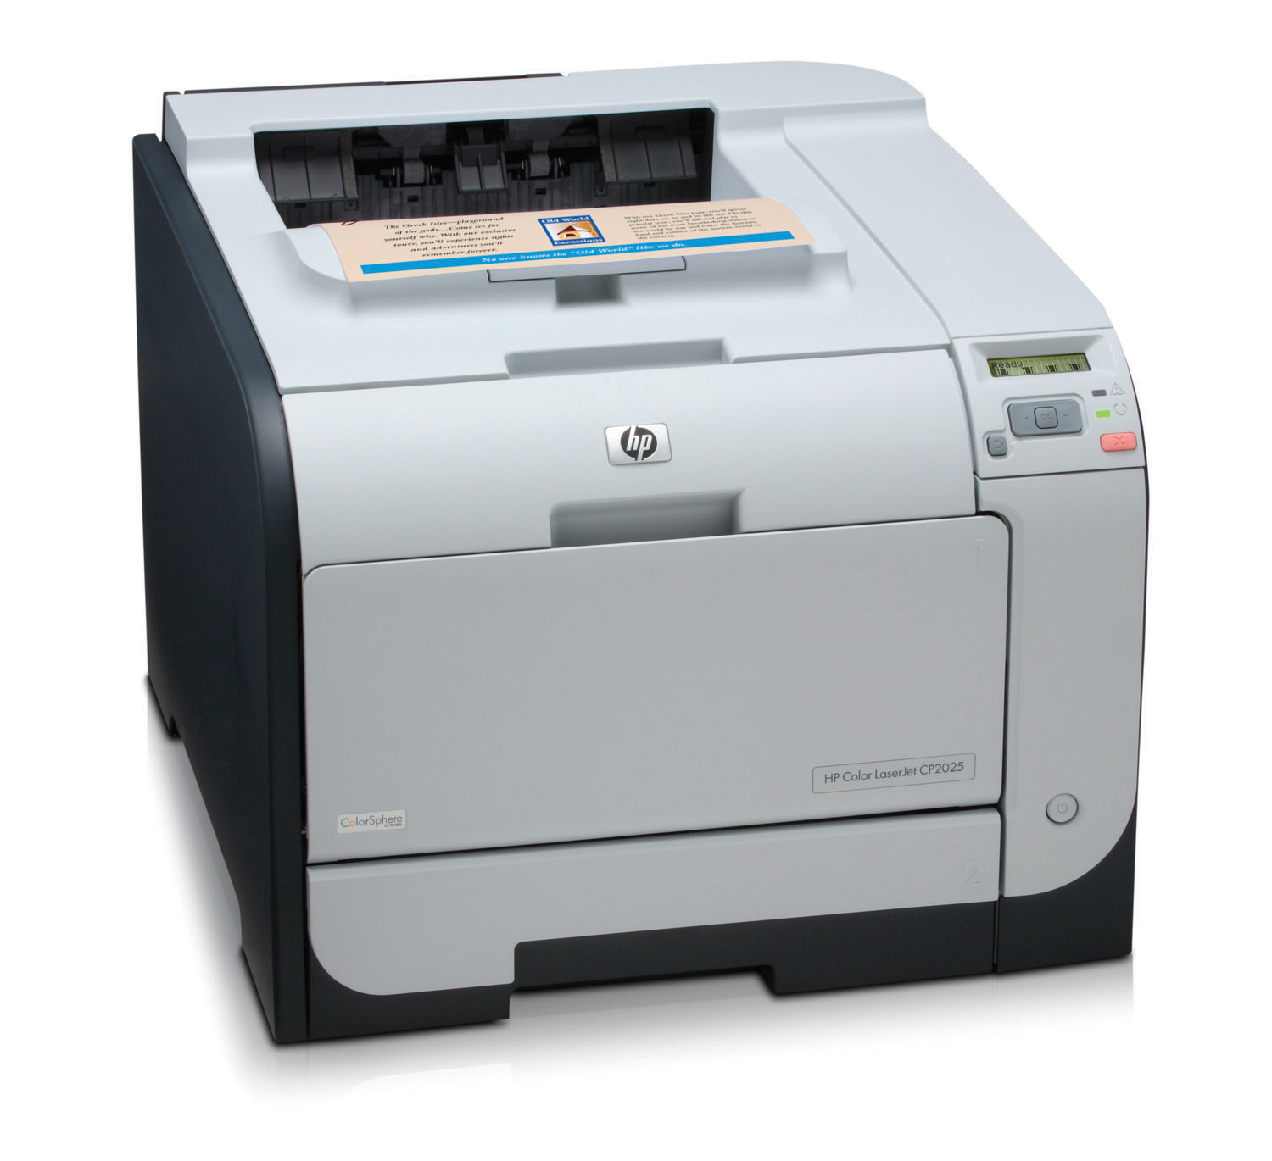

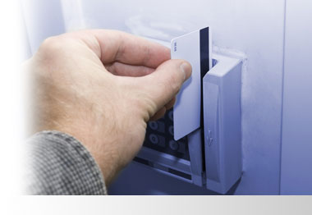
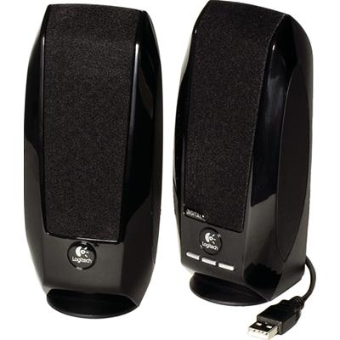
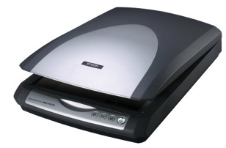
Hardware
Prog 1
Prog 2
Prog 3
CPU
RAM
Output devices
Central Unit
Input devices

Slide 5
CPU
Prog 1
Prog 2
Prog 3
Fetch
Control Unit
2) Decoding
Arithmetic and Logic Unit
3) Executing
Central Processing Unit

Slide 6
RAM
Prog 1
Prog 2
Prog 3
CPU
User Data 1
User Data 2
User Data 3
Other data
Hard Drive
RAM

Slide 7
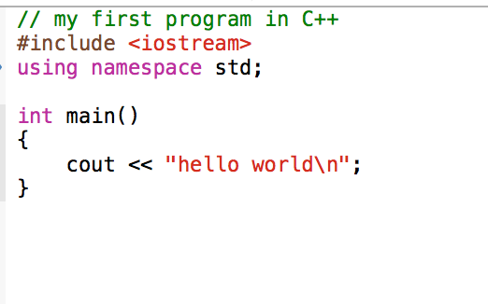
Code
Executable code
compiler
code

Slide 8
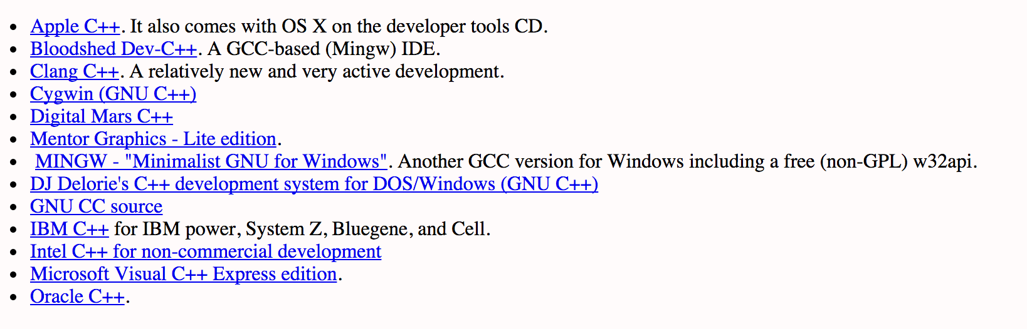
Compiler

Slide 9
Source code, object code, executable code
Modified source code
Preprocessor
compiler
C++
Object code
source code
Executable code
linker

